Slide 1
Jacob Summer Update IV
Optimization

Slide 2
Overview
To build a dynamic robot capable of balancing and hopping
Incorporate force measurement device
Begin with hopping 2dof leg
Use simulation to inform design

Slide 3
Literature – R.S. Fearing
Power Modulation and Optimization

Slide 4
Tasks
Use Unity to:
Model spring, joints, and contact
Collect data
Respond to feedback and actuate mechanism
Enable interaction
Build simulation of leg
Use simulation to:
Select leg dimensions
Determine spring characteristics
Select motors
Manufacture first prototype
Design harness
Manufacture harness
Write vertical hopping code
Test code in simulation
Test hopping with actual leg

Slide 5
Simulation MATLAB
Moment arm vs jump height with
100 rpm motor --> 1.02m moment arm and 1.447m jump height
300 rpm motor --> .182m moment arm and .519m jump height
Motor internal gear ratio vs jump height with
.05m moment arm --> 668 rpm and .2995m
.1m moment arm --> 432 rpm and .358m
Small increase in motor speed results in large reduction of ideal moment arm
Less leg-lengths of jump height for larger moment arm

Slide 6
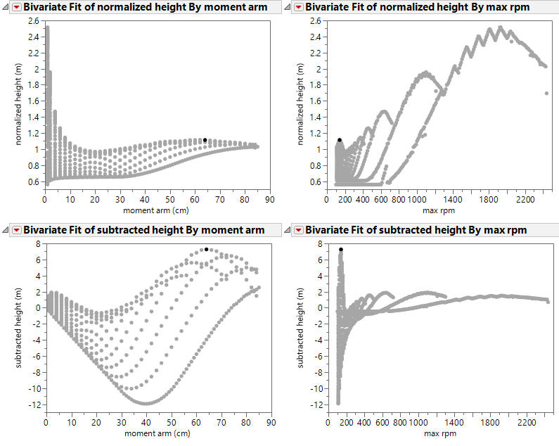
Simulation Unity
Iterate through lengths and gear ratios
Best gauge of height
Limit of moment arm length

Slide 7
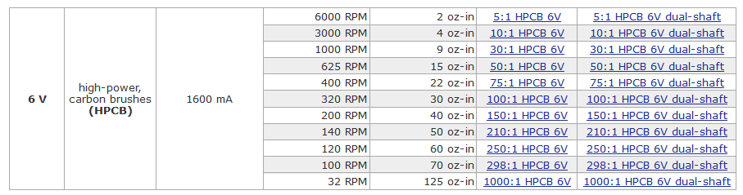
Motor

